Slide 1



Chapter
1
Introduction to Statistics
© 2012 Pearson Education, Inc.
All rights reserved.
<number> of 61
Notes:
Larson/Farber 4th ed
Chapter 1

Slide 2
Chapter Outline
1.2 Data Classification
© 2012 Pearson Education, Inc. All rights reserved.
<number> of 61

Slide 3
Section 1.2
Data Classification
© 2012 Pearson Education, Inc. All rights reserved.
<number> of 61

Slide 4
Section 1.2 Objectives
Distinguish between qualitative data and quantitative data
Classify data with respect to the four levels of measurement
© 2012 Pearson Education, Inc. All rights reserved.
<number> of 61

Slide 5



Types of Data
Qualitative Data
Consists of attributes, labels, or nonnumerical entries.
Major
Place of birth
Eye color
© 2012 Pearson Education, Inc. All rights reserved.
<number> of 61

Slide 6



Types of Data
Quantitative data
Numerical measurements or counts.
Age
Weight of a letter
Temperature
© 2012 Pearson Education, Inc. All rights reserved.
<number> of 61

Slide 7
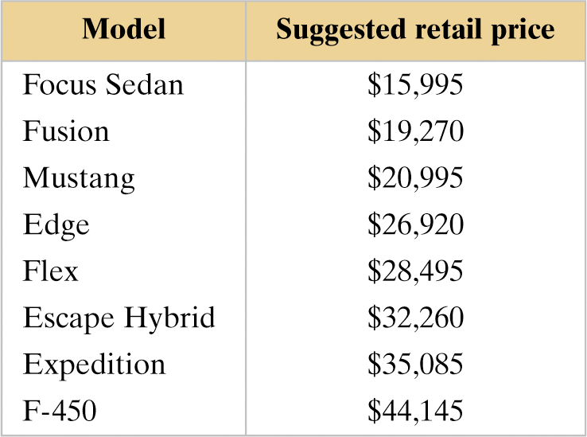
Example: Classifying Data by Type
The suggested retail prices of several vehicles are shown in the table. Which data are qualitative data and which are quantitative data? (Source Ford Motor Company)
© 2012 Pearson Education, Inc. All rights reserved.
<number> of 61

Slide 8
Solution: Classifying Data by Type
Qualitative Data (Names of vehicle models are nonnumerical entries)
Quantitative Data (Suggested retail prices of vehicle models are numerical entries)
© 2012 Pearson Education, Inc. All rights reserved.
<number> of 61

Slide 9
Levels of Measurement
Nominal level of measurement
Qualitative data only
Categorized using names, labels, or qualities
No mathematical computations can be made
Ordinal level of measurement
Qualitative or quantitative data
Data can be arranged in order
Differences between data entries is not meaningful
© 2012 Pearson Education, Inc. All rights reserved.
<number> of 61

Slide 10

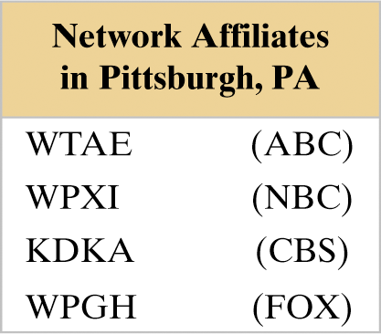
Example: Classifying Data by Level
Two data sets are shown. Which data set consists of data at the nominal level? Which data set consists of data at the ordinal level? (Source: Nielsen Media Research)
© 2012 Pearson Education, Inc. All rights reserved.
<number> of 61

Slide 11
Solution: Classifying Data by Level
Ordinal level (lists the ranks of five TV programs. Data can be ordered. Difference between ranks is not meaningful.)
Nominal level (lists the call letters of each network affiliate. Call letters are names of network affiliates.)
© 2012 Pearson Education, Inc. All rights reserved.
<number> of 61

Slide 12
Levels of Measurement
Interval level of measurement
Quantitative data
Data can be ordered
Differences between data entries are meaningful
Zero represents a position on a scale (not an inherent zero – zero does not imply “none”)
© 2012 Pearson Education, Inc. All rights reserved.
<number> of 61

Slide 13
Levels of Measurement
Ratio level of measurement
Similar to interval level
Zero entry is an inherent zero (implies “none”)
A ratio of two data values can be formed
One data value can be meaningfully expressed as a multiple of another
© 2012 Pearson Education, Inc. All rights reserved.
<number> of 61

Slide 14
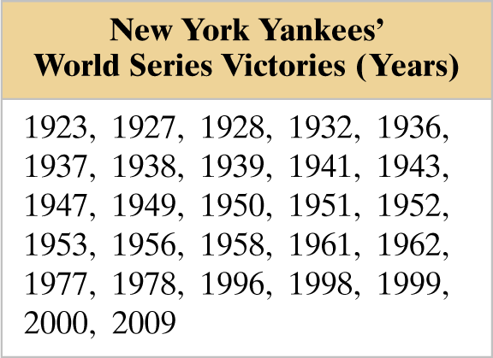
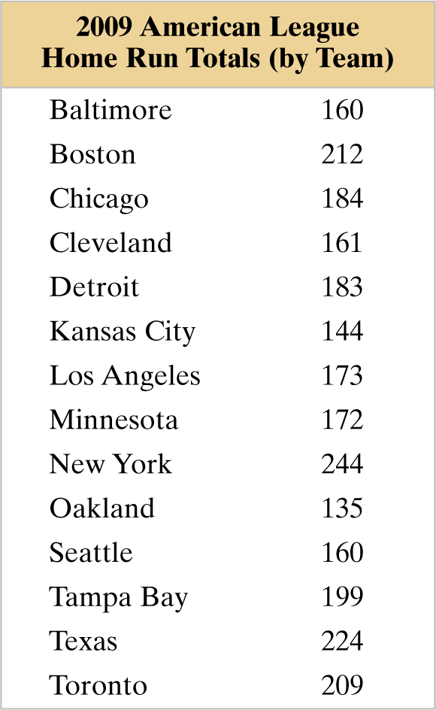
Example: Classifying Data by Level
Two data sets are shown. Which data set consists of data at the interval level? Which data set consists of data at the ratio level? (Source: Major League Baseball)
© 2012 Pearson Education, Inc. All rights reserved.
<number> of 61

Slide 15
Solution: Classifying Data by Level
Interval level (Quantitative data. Can find a difference between two dates, but a ratio does not make sense.)
Ratio level (Can find differences and write ratios.)
© 2012 Pearson Education, Inc. All rights reserved.
<number> of 61

Slide 16
Summary of Four Levels of Measurement
Level of Measurement | Put data in categories | Arrange data in order | Subtract data values | Determine if one data value is a multiple of another
Nominal | Yes | No | No | No
Ordinal | Yes | Yes | No | No
Interval | Yes | Yes | Yes | No
Ratio | Yes | Yes | Yes | Yes
© 2012 Pearson Education, Inc. All rights reserved.
<number> of 61

Slide 17
Section 1.2 Summary
Distinguished between qualitative data and quantitative data
Classified data with respect to the four levels of measurement
© 2012 Pearson Education, Inc. All rights reserved.
<number> of 61

